Slide 1
Chapter 4: Threads
Mar, 2024

Slide 2
Outline
Processes vs threads
Thread Implementation
Multi-programming
Linux thread library

Slide 3
Objectives
To introduce the notion of a thread—a fundamental unit of CPU utilization that forms the basis of multithreaded computer systems
To discuss the different models of threads and the implementation
To cover operating system support and APIs for threads in Linux/Windows

Slide 4

Why not function calls
fun_send()
fun_receive()

Slide 5
Execution of Function Call
main
fun1
int main()
{
fun1();
fun2();
……;
}
void fun1();
{
fun3();
}
fun3
fun2
A Single Thread
send() and receive() ?

Slide 6
Why not processes
Send_process
Receive_process
进程之间的隔离保护

Slide 7
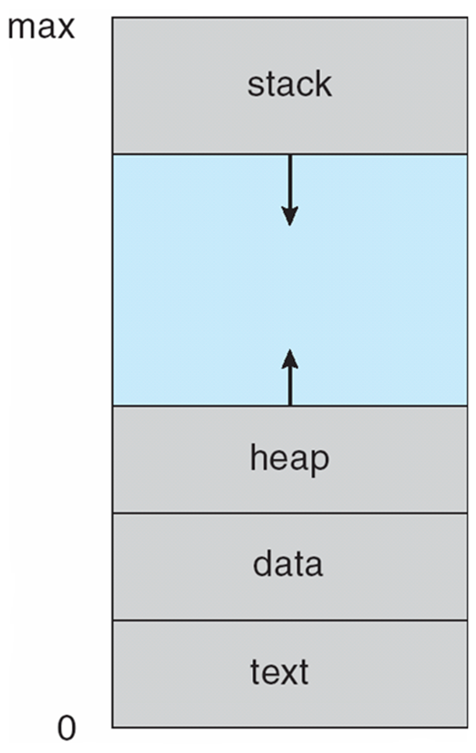

How to make multiple threads?
main
fun1
int main()
{
fun1();
fun2();
……;
}
void fun1();
{
fun3();
}
fun3
保存
跳转
恢复
返回
fun2
Notes:
https://blog.csdn.net/gzxb1995/article/details/104910787

Slide 8
How to make multiple threads?
main
fun1
int main()
{
fun1();
fun2();
……;
}
void fun1();
{
fun3();
}
fun3
main
保存
跳转
恢复
fun1
fun2
返回
fun3
fun2
上下文(寄存器)、栈

Slide 9
Threads
A thread is a basic unit of CPU utilization（使用）
process: basic unit of resource allocation
It comprises（包括） a thread ID, a program counter (PC), a register set, and a stack
It shares with other threads belonging to the same process its code section, data section, and other operating-system resources, such as open files and signals
既要多线并发，又要资源共享

Slide 10
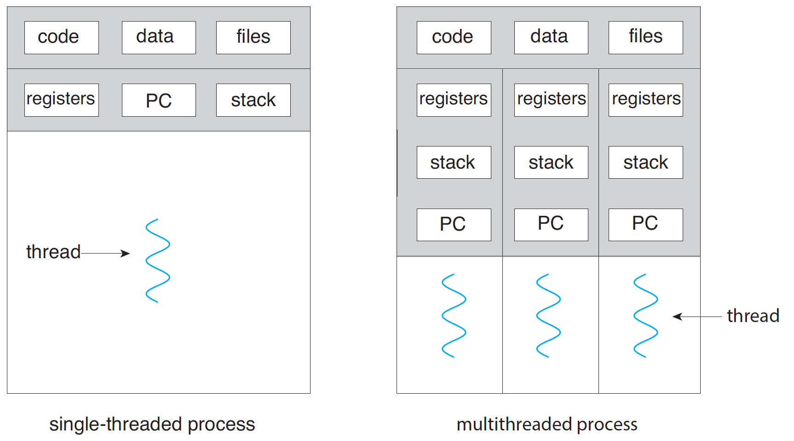
Process vs Threads
Notes:
除了stack registers and PC，其它都共享，包括heap。
Local var等储存在stack中

Slide 11
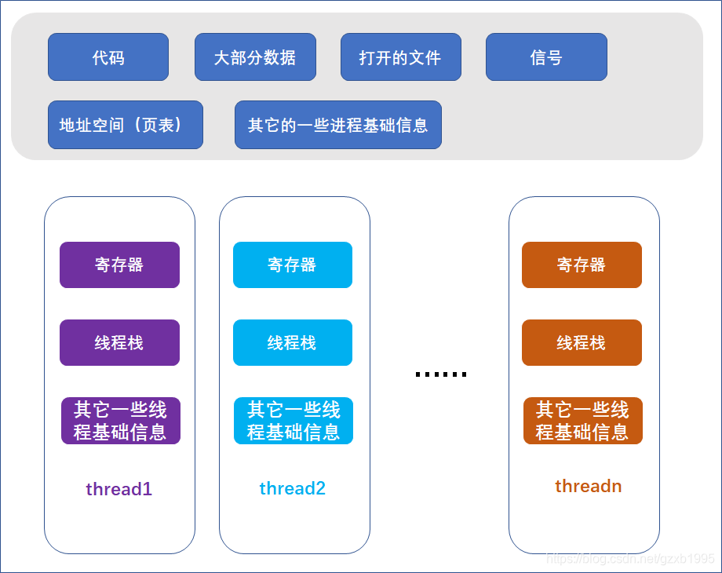
Process vs Threads

Slide 12
Benefits of Threads
Responsiveness – may allow continued execution if part of process is blocked, especially important for user interfaces (UI)
Scalability – can take advantage of multiprocessor architectures (Web server)
Resource Sharing – threads share resources of process, easier than shared memory or message passing (Word)
Economy – cheaper than process creation, thread switching lower overhead than context switching
Notes:
webpage

Slide 13
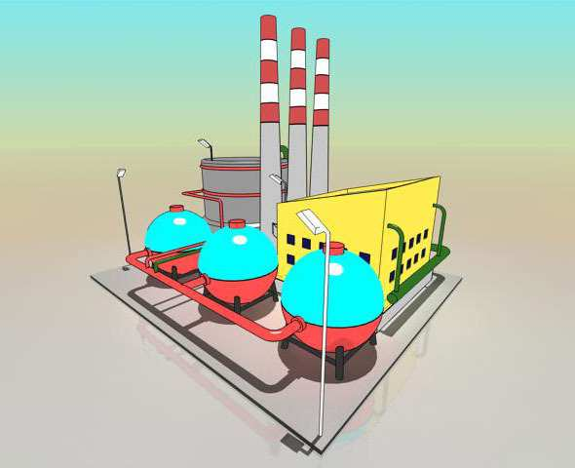
CPU as a Factory
http://www.ruanyifeng.com/blog/2013/04/processes_and_threads.html
Notes:
计算机的核心是CPU，它承担了所有的计算任务。它就像一座工厂，时刻在运行

Slide 14

Process as a Workshop
Notes:
工厂的电力有限，一次只能供给一个车间使用。也就是说，一个车间开工的时候，其他车间都必须停工。背后的含义就是，单个CPU一次只能运行一个任务
进程就好比工厂的车间，它代表CPU所能处理的单个任务。任一时刻，CPU总是运行一个进程，其他进程处于非运行状态。

Slide 15

Thread as a Worker
Notes:
线程就好比车间里的工人。一个进程可以包括多个线程。

Slide 16
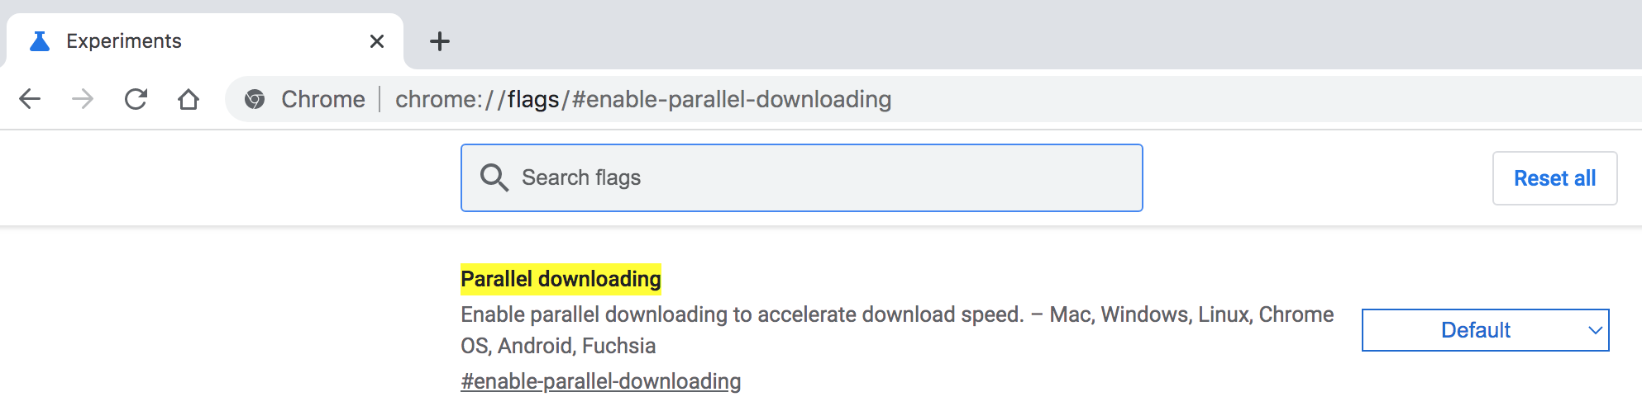
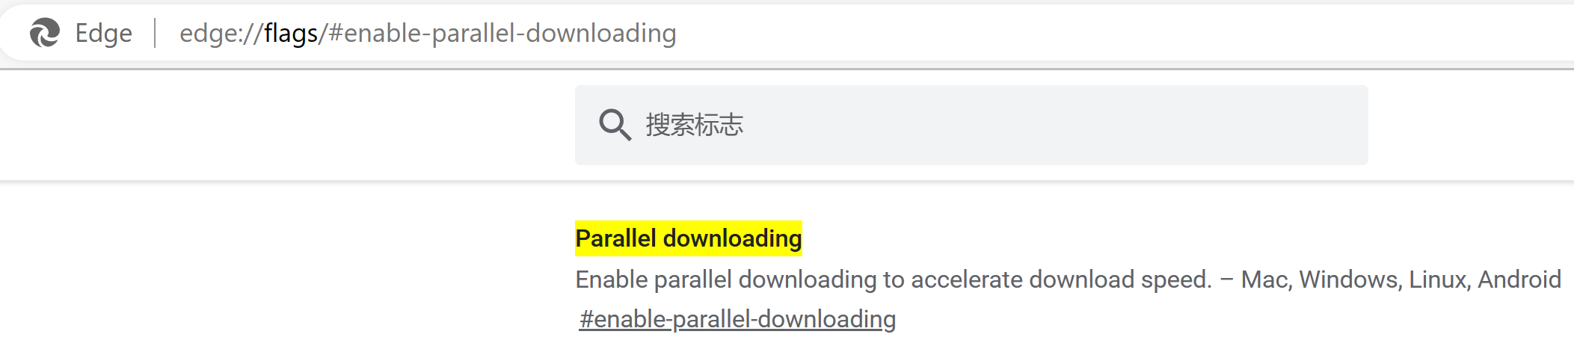
Question
Give a multi-threaded scenario?
Notes:
chrome://flags/#enable-parallel-downloading

Slide 17
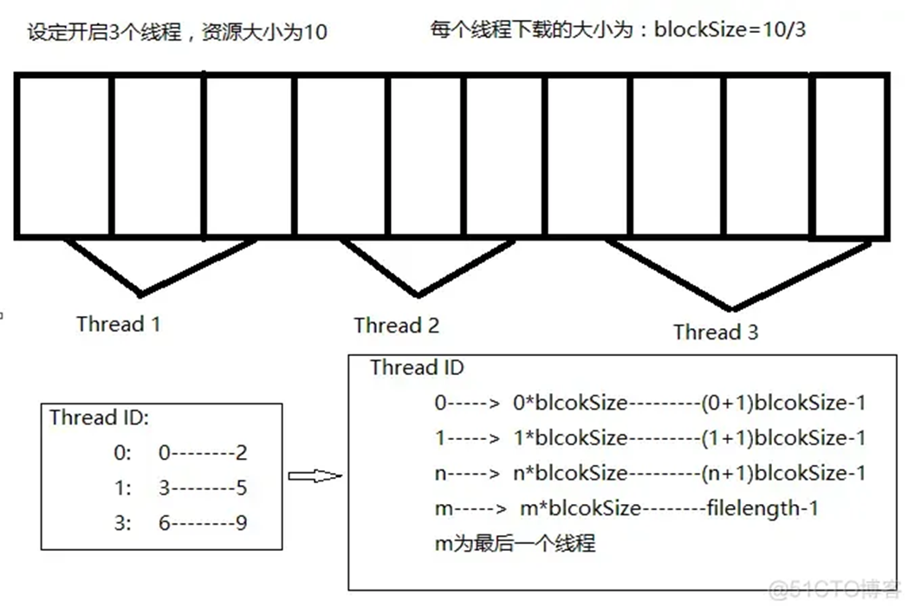
Parallel Download

Slide 18
Thread Implementation

Slide 19
Thread Stack
主线程栈
(main)
Thread 1
Thread 2

Slide 20
How to represent a thread
Thread control block (TCB)
PCB
Process identifier
Program counter
CPU registers
Memory-management information
I/O status information
Process state
CPU scheduling information
Accounting information
TCB
①线程标识符
②一组寄存器
③线程运行状态
④优先级
⑤线程专有存储区
⑥信号屏蔽
⑦堆栈指针
Notes:
①线程标识符，为每个线程赋予一个唯一的线程标识符;
②一组寄存器，包括程序计数器PC、状态寄存器和通用寄存器的内容
③线程运行状态，用于描述线程正处于何种运行状态;
④优先级，描述线程执行的优先程度;
⑤线程专有存储区，用于线程切换时存放现场保护信息，和与该线程相关的统计信息等;
⑥信号屏蔽，即对某些信号加以屏蔽;
⑦堆栈指针，

Slide 21
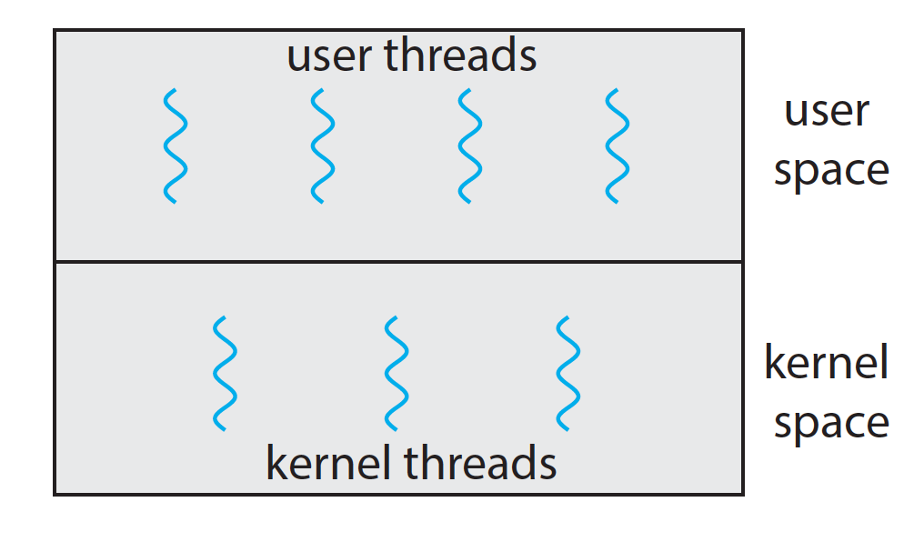
Who manages TCB?
User threads - management done by user-level threads library
Kernel threads - supported by the Kernel
Notes:
ps -eLf: kernel threads
ps -e
ps -l
ps -L
ps -f

Slide 22
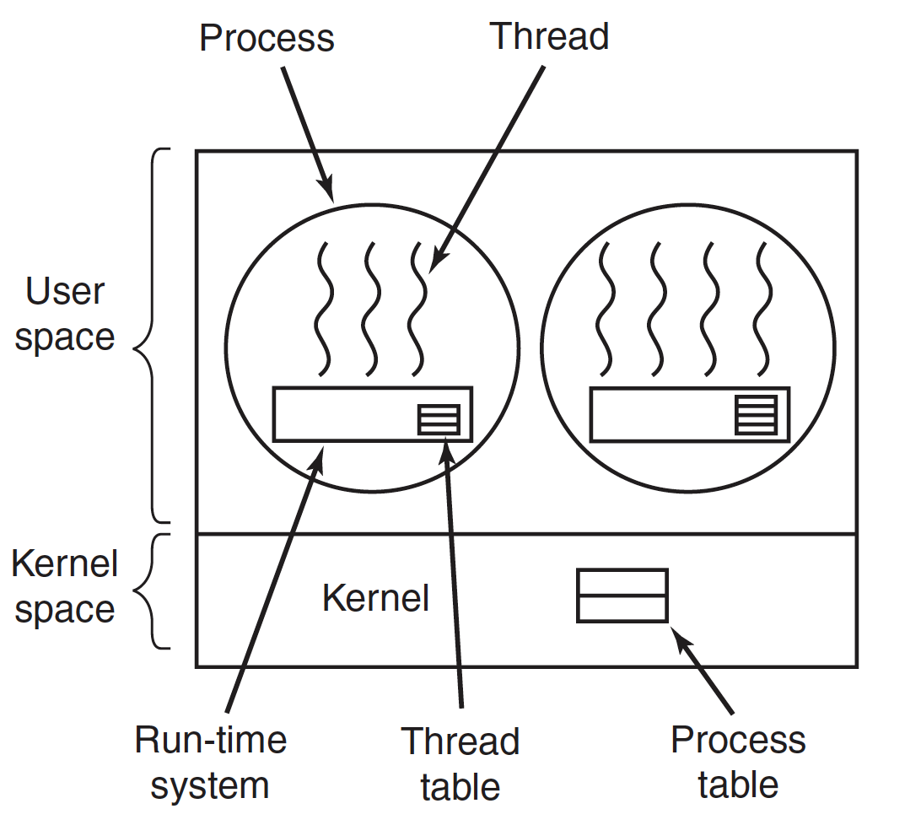
How to schedule: Many-to-One

Slide 23
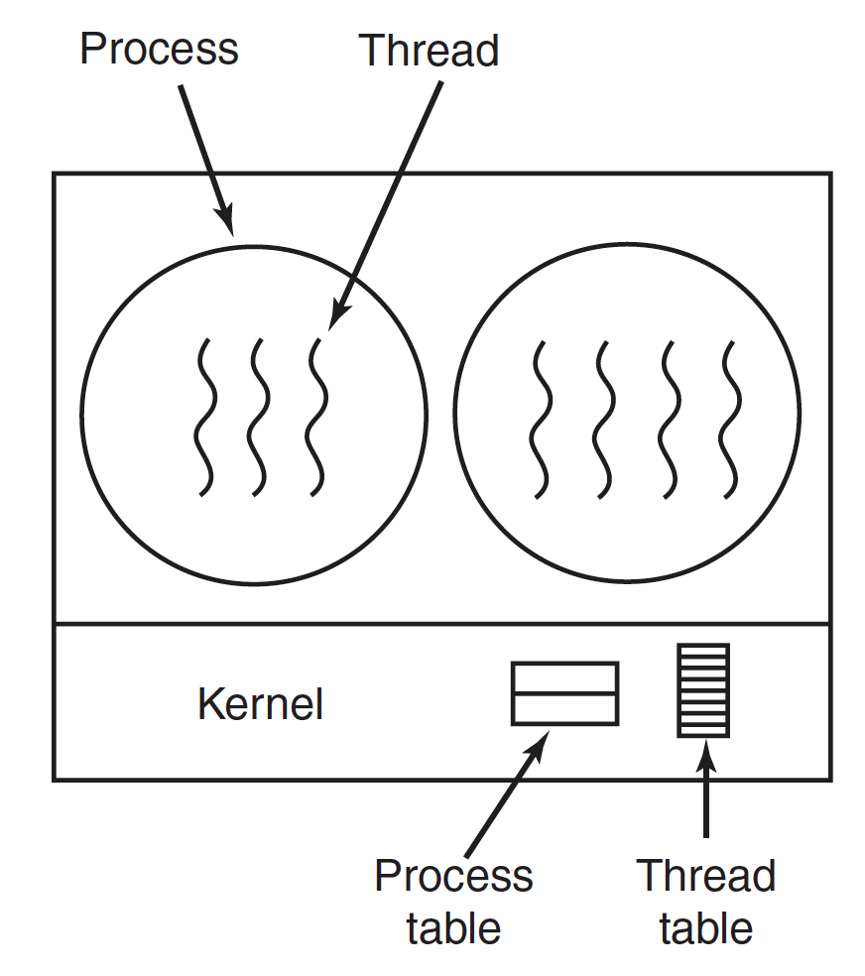
How to schedule: One-to-One
Notes:
One user thread match one kernel thread

Slide 24
Comparison
Strengths of many-to-one
User threads are more efficient
Can run on any system
Weakness of many-to-one
One thread blocking causes all to block
Multiple threads may not run in parallel on muti-core system because only one may be in kernel at a time
Notes:
一个阻塞，进程内的全部线程阻塞。
同时只有一个能陷入内核。

Slide 25
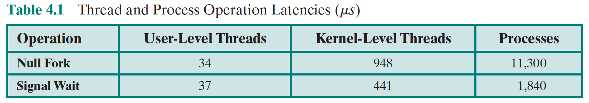

Cost
demo
Notes:
Demo of system call cost

Slide 26
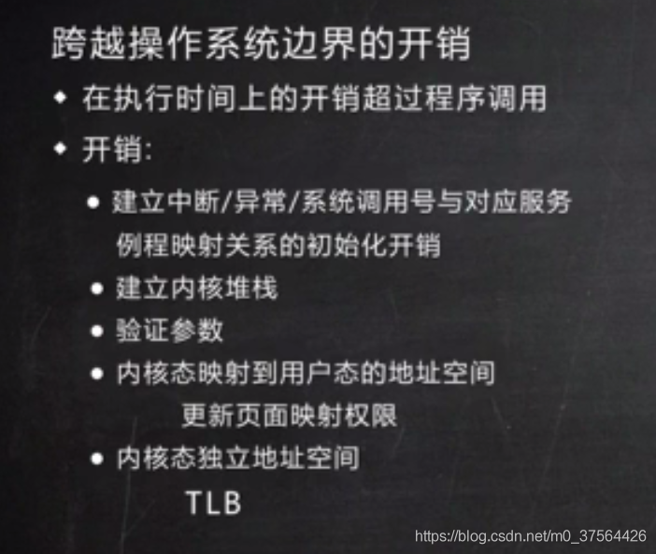
User vs Kernel：跨越操作系统边界开销

Slide 27
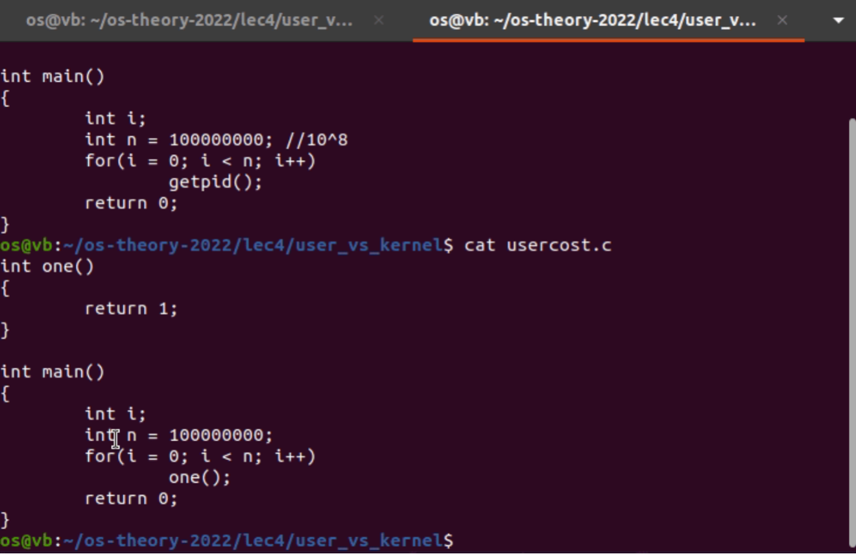
Function Call vs System Call (1)
Notes:
Getpid()属于system call要trap in kernal

Slide 28
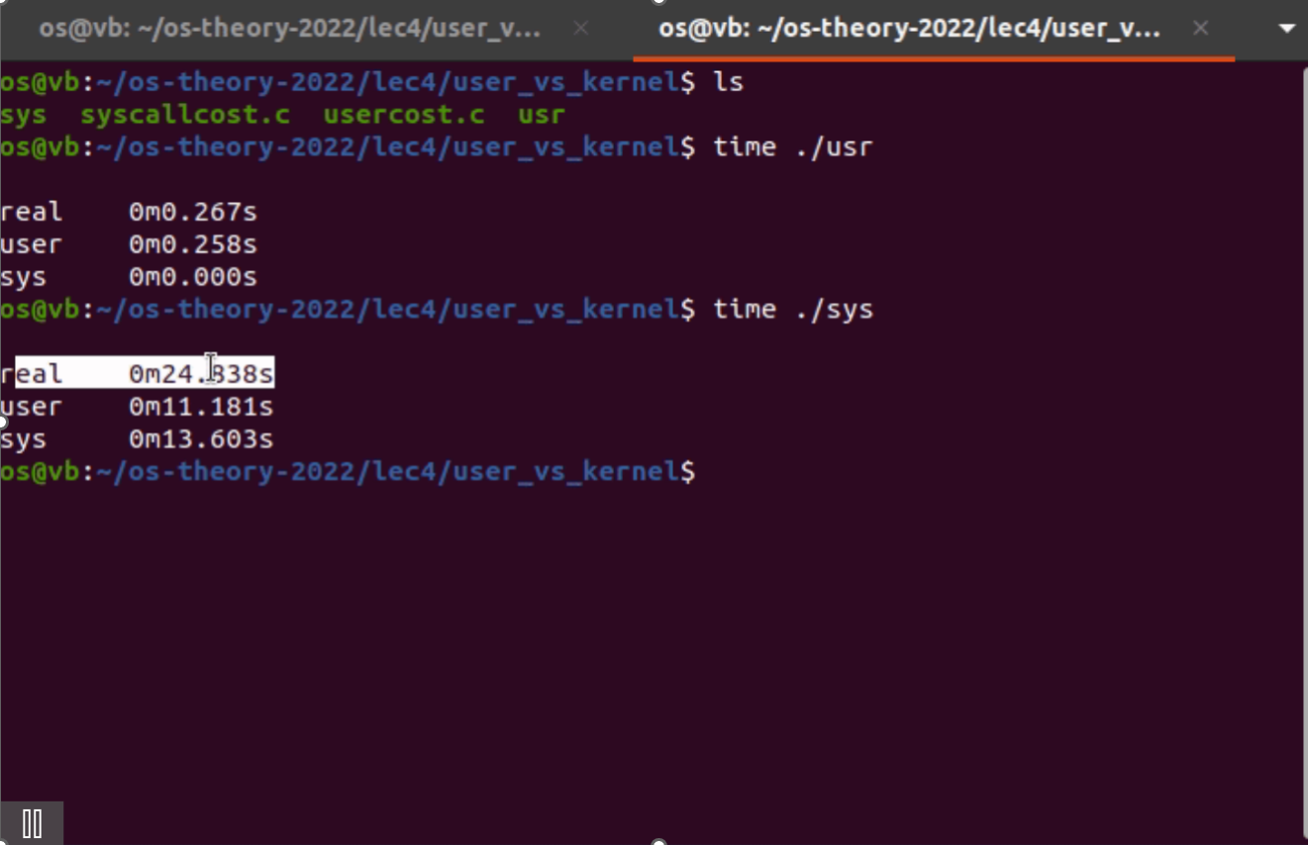
Function Call vs System Call (2)

Slide 29
Thread API

Slide 30
Thread Libraries
Thread library provides programmer with API for creating and managing threads
Pthread
Windows
Java
Pthread
A POSIX standard (IEEE 1003.1c) API for thread creation and synchronization
Specification, not implementation
API specifies behavior of the thread library, implementation is up to development of the library
Common in UNIX operating systems (Solaris, Linux, Mac OS X)

Slide 31
API
fork pthread_create
exit pthread_exit
wait pthread_join
getpid pthread_self
abort pthread_cancel
Notes:
ps -eLf
-pthread

Slide 32
Multithreaded Programming

Slide 33
Multicore Programming
Parallelism(并行性) implies a system can perform more than one task simultaneously
Concurrency（并发性） supports more than one task making progress
Single processor / core, scheduler providing concurrency

Slide 34
Concurrency vs. Parallelism
Concurrent execution on single-core system:
Parallelism on a multi-core system:

Slide 35
Type of parallelism
Types of parallelism
Data parallelism – distributes subsets of the same data across multiple cores, same operation on each
Task parallelism – distributing tasks across cores, each thread performing unique operation
Hybrid

Slide 36
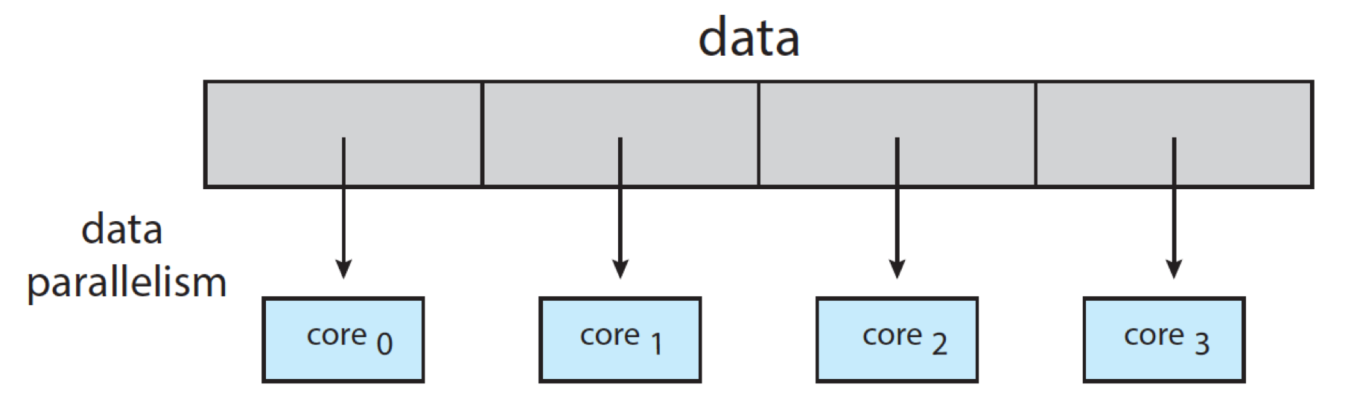
Type of parallelism
Notes:
数据被分割成多个块，每个块独立处理。

Slide 37
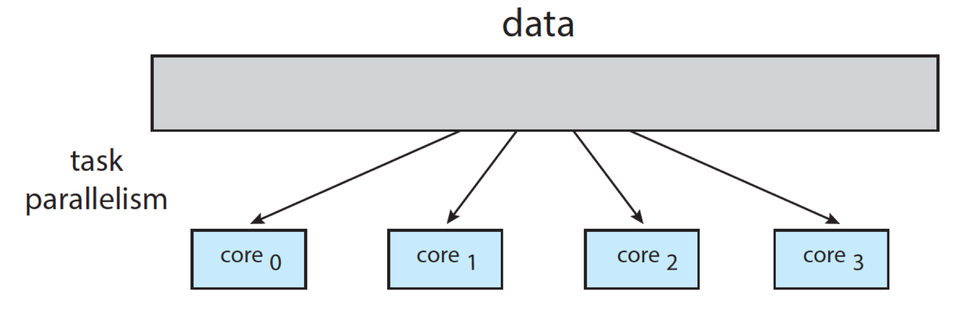
Type of parallelism
Notes:
将一个大型任务分解为多个可以独立执行的子任务，并将这些子任务分配给不同的处理器或核心

Slide 38
Challenges
Multicore or multiprocessor systems putting pressure on programmers, challenges include:
Dividing activities
Data splitting
Data dependency
Balance
Testing and debugging

Slide 39
Thread Pool

Slide 40
Thread Pools

Slide 41
Thread Pools
Create a number of threads in a pool where they await work
Advantages:
Usually slightly faster to service a request with an existing thread than create a new thread
Allows the number of threads in the application(s) to be bound to the size of the pool
Notes:
使用现有的线程，不用现创建，速度快
只能用池里的线程，限制了数量，防止过多线程并发占有资源过多。

Slide 42
End of Chapter 4

Slide 43
How about user level threads?
User level threads in Linux?
ucontext API
demo
Notes:
uncontext hello world

Slide 44
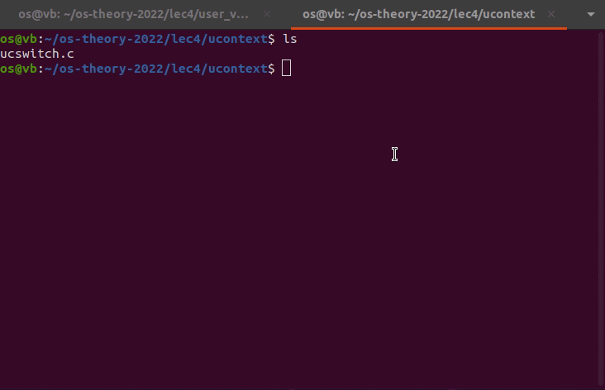
User Context

Slide 45
Linux Threads
Thread creation is done through clone() system call
clone() allows a child task to share the address space of the parent task (process)
Flags control behavior

Slide 46
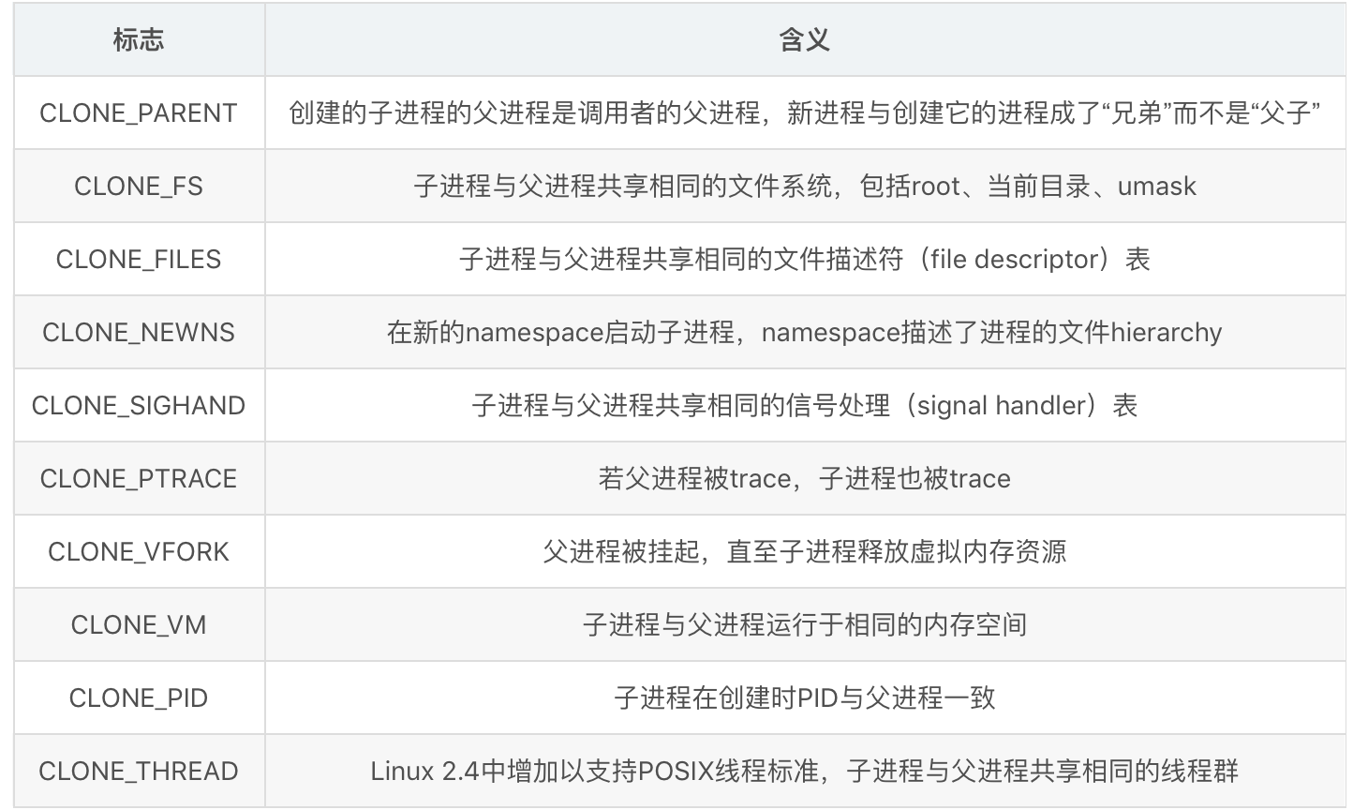
clone() flags
Notes:
strace ./a.out

Slide 47
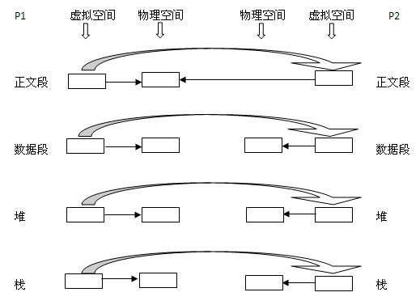
Process creation: fork()
Notes:
内存空间复制（代码段除外）
PCB复制（更改内存空间）

Slide 48
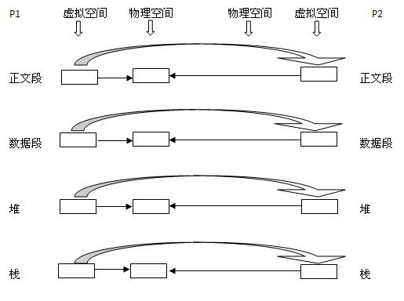
More about fork（）
Notes:
This should be fork with copy-on-write

Slide 49
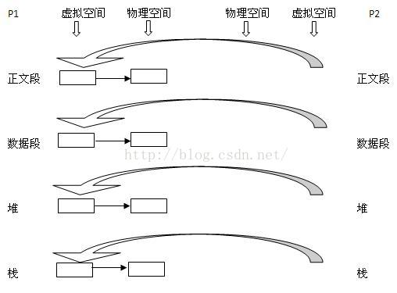
clone()
Notes:
This should be clone() with clone_vm
PCB也复制吗

